Slide 1

Social Science and Humanities
Belarus 2025
Andrei Kazakevich

Slide 2
Number of researchers by field of science (people)

Slide 3
Number of Researchers,
Social Sciences

Slide 4
Number of researchers (humanities)

Slide 7
Expenditure on R&D in social sciences and humanities, million USD

Slide 8
Expenditure on R&D in technical sciences, million USD

Slide 9
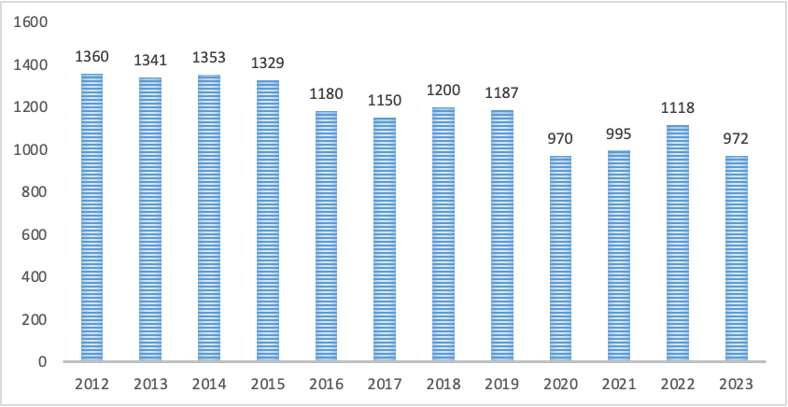
Number of scientific books published in Belarus, 2012-2023

Slide 10
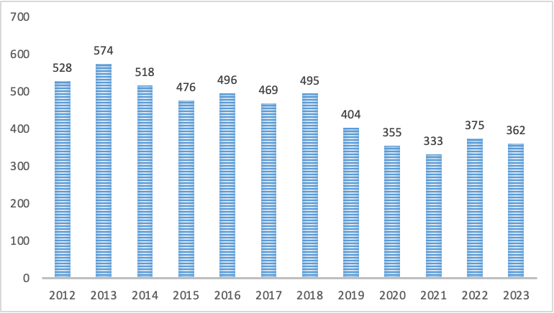
Number of published dissertations in 2012-2023

Slide 11
Average number of dissertations approved per year, 2015-2024
Economy | 40.8
History | 24.6
Sociology | 6.9
Political science | 5.4
Philosophy | 3.7

Slide 13
Languages of dissertations, 2015-2022
 | Economy | Political science | Philosophy | Sociology | History
Russian | 100% | 100% | 86% | 100% | 77%
Belarusian |  |  | 14% |  | 33%

Slide 14
Recovery (replacement) growth in the number of researchers after the decline of 2020 (social sciences) 2021-2022 (humanities)
Research spending growth from 2022
A general decline in scientific output over the past five years
The Belarusian research community remains one of the smallest and underfunded in the region

