Slide 1
Main trends in Belarus and Poland relations
2024-2025

Slide 2
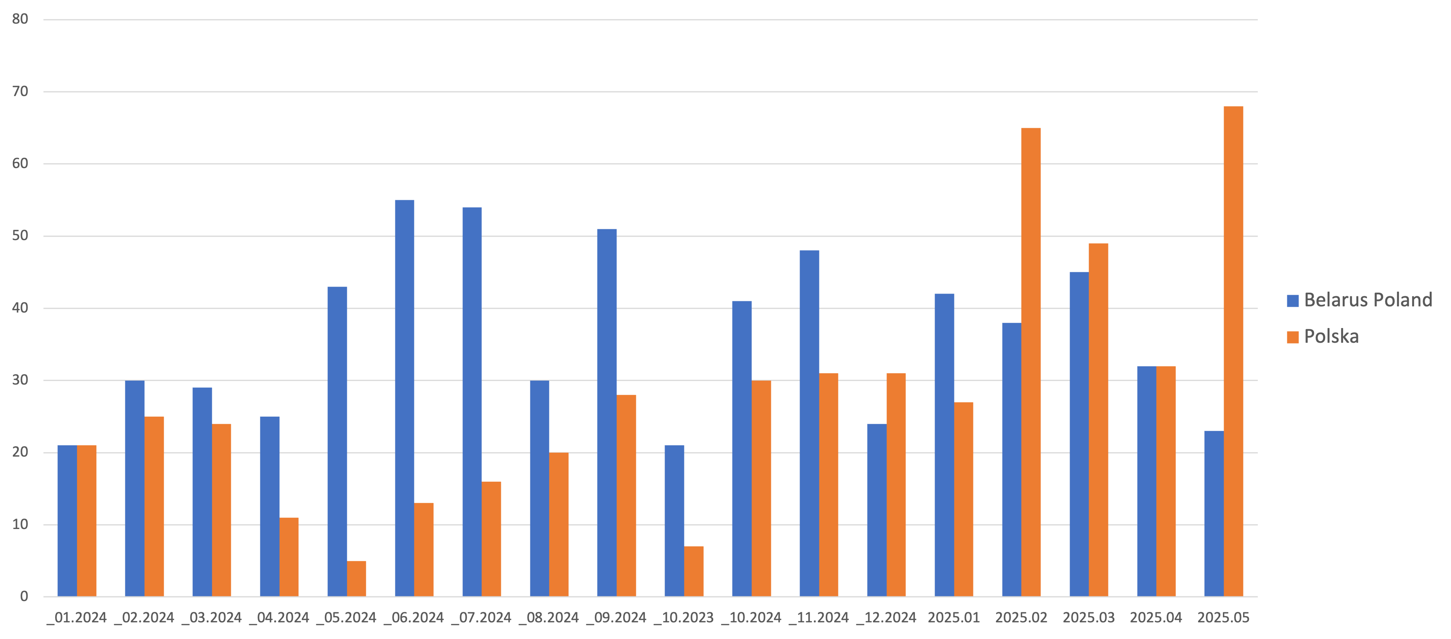
General information flow of Belarusian state media (BELTA)

Slide 3
Topics
 | 01.2024-09.2024 | 10.2024-05.2025 | сума
Security | 104 | 104 | 208
Boarder (queue) | 91 | 114 | 205
Internal policy | 73 | 107 | 180
Ukraine | 26 | 73 | 99
Migration crisis | 44 | 39 | 83
Visa free, tourism | 36 | 38 | 74
Grand Total | 501 | 654 | 1155

Slide 4
Speakers
 | 01.2024-09.2024 | 10.2024-05.2025 | Total
Border Committee | 105 | 149 | 254
Lukashenka | 29 | 20 | 49
MFA | 23 | 12 | 35
«People» | 10 | 24 | 34
Tusk | 9 | 24 | 33
Duda | 10 | 14 | 24

Slide 5
Statements by officials

Slide 6
Main thesis last 6 months (Lukashenka)
Russia (and Belarus) are not a threat to Poland (3-4)
Proposals for developing cooperation (3-4)
Threat from Poland (take Western Belarus and Ukraine, Catholicism, "fugitive" militants) 2-3
World War II (ungrateful Poland)
International affairs (you can't bet on Poland as a partner)

Slide 7
Main thesis (Lukashenka)
Poland is pursuing the most aggressive and bad policy against Belarus. … We are your neighbors, we have lived in one state for many years. Bad, good... Today you are laying claim to Western Belarus including Minsk, they have already started talking about Western Ukraine. Why do you need this empire?
26.01.2025

Slide 8
Main thesis last 6 months (MFA)
Militarization of Poland, growth of military asymmetry
Polish Presidency of the EU (strategy of confrontation, sanctions, rejection of cooperation)
Elections in Belarus (criticism of criticism, criticism of support for democratic forces etc.)
Diaspora (alleged growth of discrimination and violence)

Slide 9
Poland is arming itself to the teeth, collecting the best weapons from around the world, from the USA to South Korea, and offensive weapons. At some point, Lithuania and Latvia are ready to spend almost their entire budget on militarization. First question: why offensive weapons?
29.01.2025

Slide 10
Belarusian society

Slide 14
Trends on key agenda items
Security | Strategic growth of asymmetry (Polish border strengthening, negotiations on Ukraine, strengthening of the Polish army)
Border and mobility | Peak of the crisis
Migration crisis | Stabilization after escalation
Diaspora | Growing discussions about attitudes, propaganda within the country, growing results of special services operations
Dynamics of political relations | Deadlock after activation 2024

