Slide 1
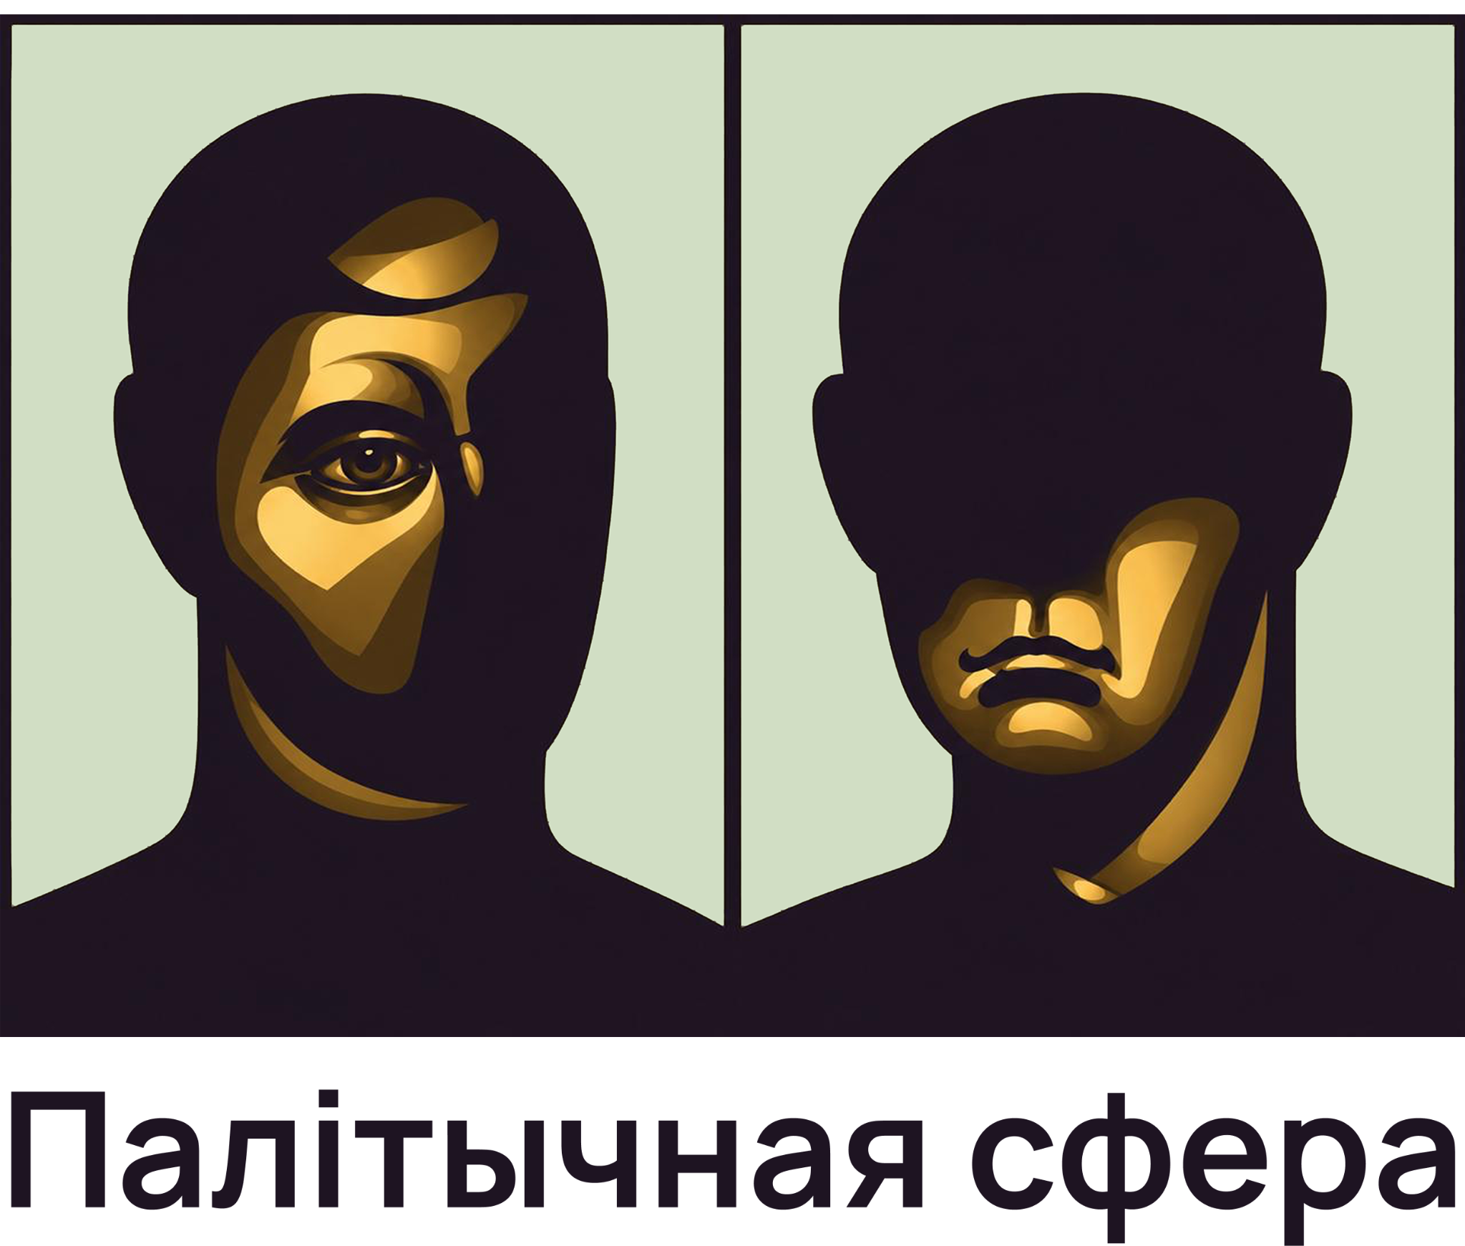

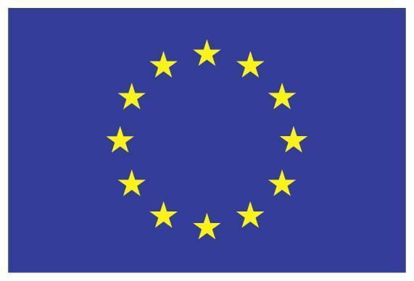
BELARUSIAN POLITICS AND
CULTURE IN UKRAINIAN PUBLIC
OPINION
Institute of Political Studies “Political Sphere”
With the financial support of the European Union
Commissioning a Sociological Survey: Attitudes of Ukrainian Citizens
towards Belarus and Belarusians in 2025 5.2.2. Analytics and studies of
issues important for the Action, EB Grant Contract NDICI-GEO-
NEAR/2023/451-320

Slide 2
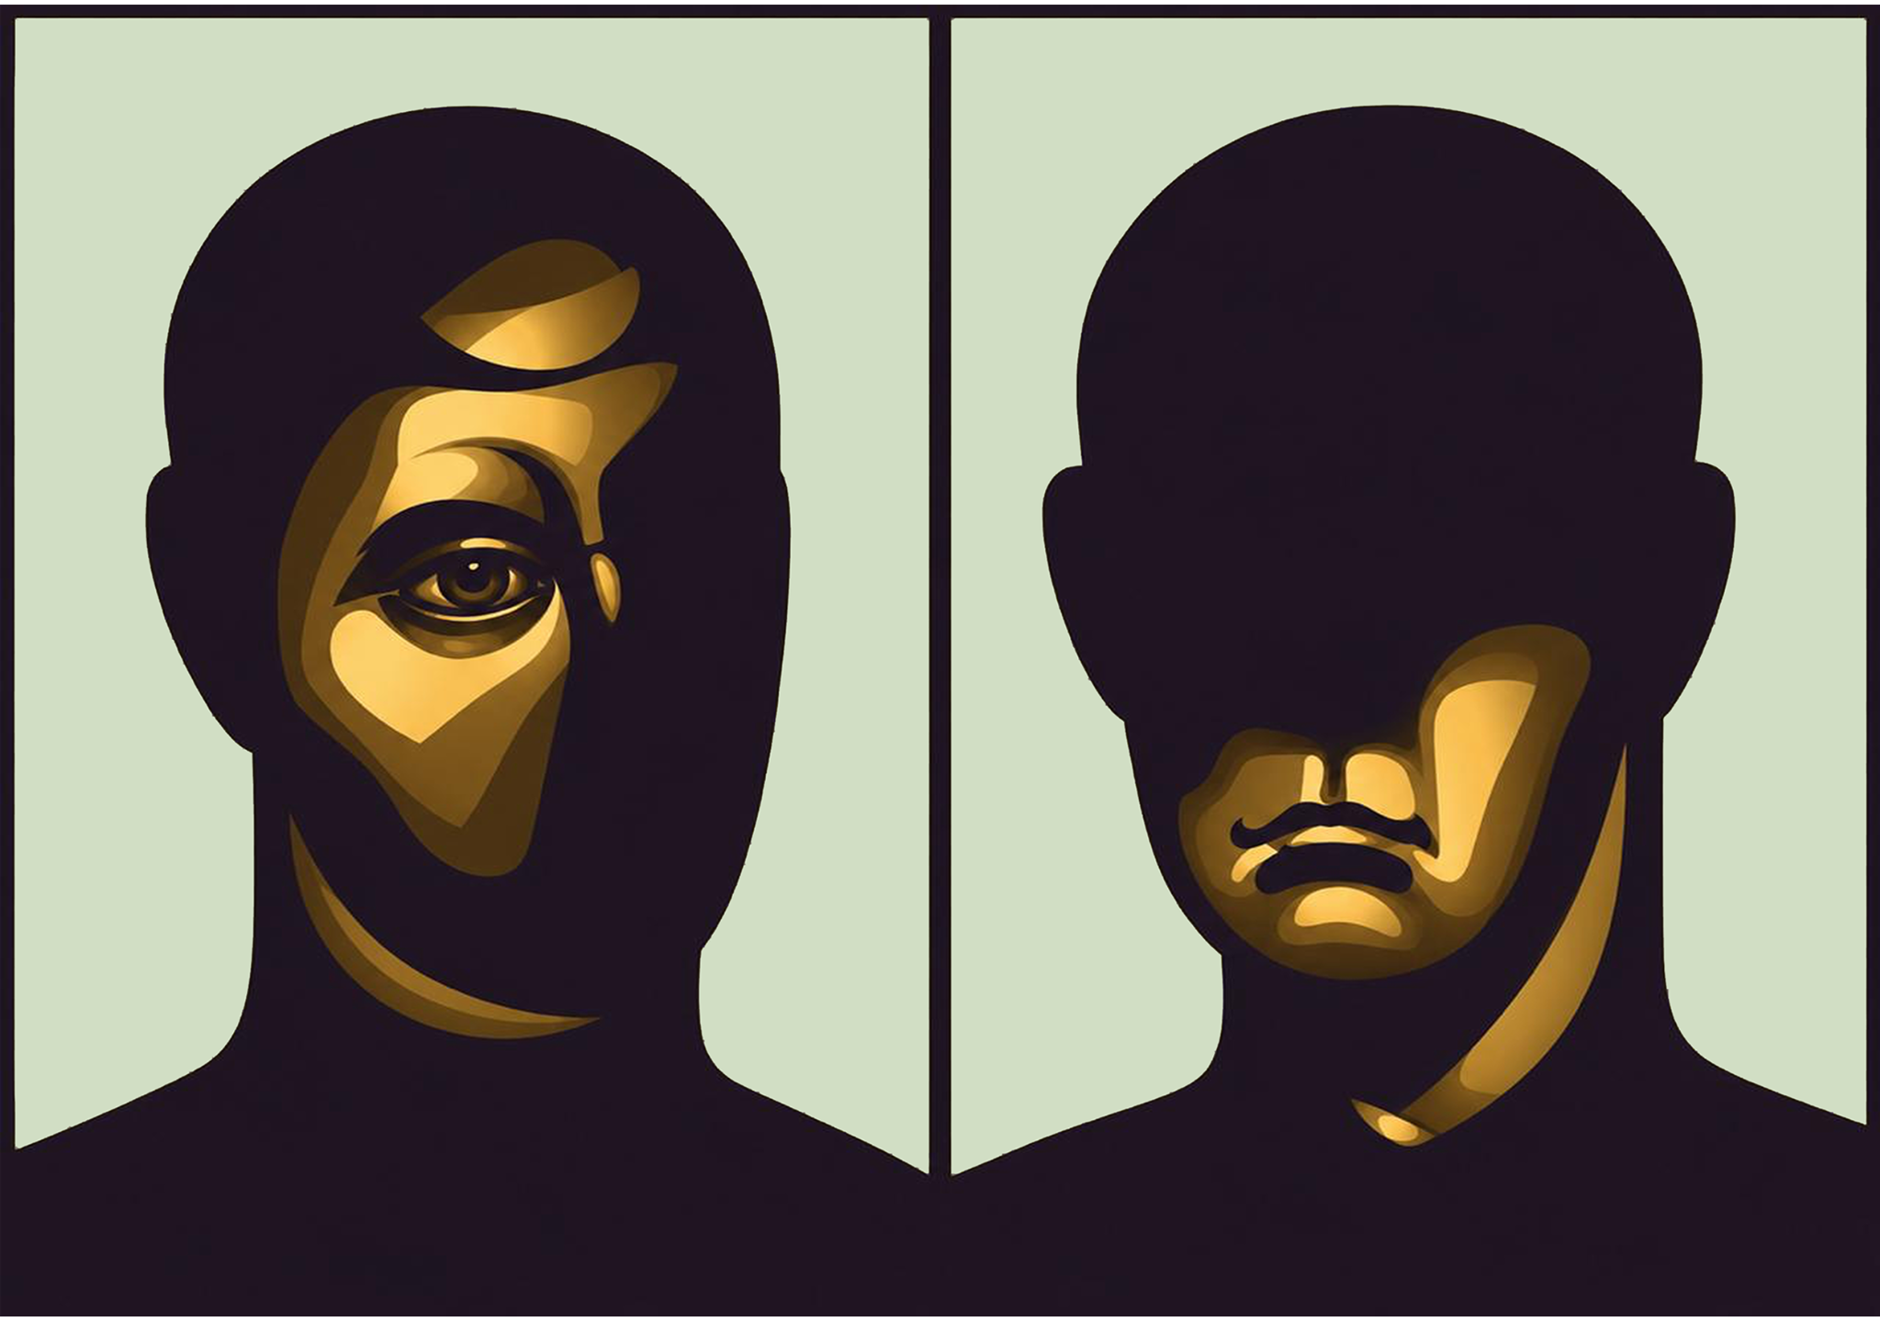
Political Sphere
Research methodology
Indicator
2022
2023
2025
2026
Sample
1026
1022
1000
1000
Fieldwork period
17–19 August
14–16 October
13–23 October
31 August – 11 September
Method
CATI
CATI
CATI
CATI (Computer-Assisted Telephone Interviewing)
Margin of error
±3,1%
±3,1%
±3,1%
±3,1%
Survey provider
InfoSapiens
InfoSapiens
InfoSapiens
—
Methodology
02

Slide 3
Political Sphere
How do you currently feel about Belarusians (citizens of Belarus)?
2022
2023
2025
2026
60%
49,3%
50,9%
49,7%
44,5%
40%
37,8%
35,6%
36,1%
33,9%
20%
18,4%
15,2%
14,0%
12,4%
0%
Positive
Negative
Hard to say
Attitudes toward Belarusians
03

Slide 4
Political Sphere
Attitudes toward citizens of Belarus: regional comparison
Positive
Negative
Hard to say
60%
49,8%
50,4%
50%
44,5%
40%
37,1%
36,6%
36,1%
32,6%
30%
25,3%
26,3%
24,3%
20%
17,6%
18,4%
10%
0%
Poland · 2026
Latvia · 2026
Lithuania · 2026
Ukraine · 2026
Attitudes toward Belarusians
04

Slide 5
Political Sphere
Attitudes toward Belarusians living in the respondent’s country
Positive
Negative
Hard to say
90%
78,0%
60%
55,7%
41,9%
30,9%
27,2%
27,8%
30%
17,7%
16,5%
4,2%
0%
Ukraine · 2026
Lithuania · 2026
Poland · 2026
Attitudes toward Belarusians
05

Slide 6
Political Sphere
Has your attitude toward citizens of Belarus changed since the start of Russia’s full-scale war against Ukraine in 2022?
0%
20%
40%
60%
Yes, changed for the better
0,4%
Yes, changed for the worse
49,5%
No, it has not changed
47,1%
Hard to say
2,9%
Attitudes toward Belarusians
06

Slide 7
Political Sphere
Why has your attitude toward citizens of Belarus changed for the worse?
0%
20%
40%
60%
80%
Military and political support for Russia by Belarus
71,0%
Inaction, silence, passivity; they do not protest against the authorities
14,5%
Complaints about the authorities and Lukashenka
5,3%
Did not support Ukraine; indifference toward Ukraine
2,1%
Personal experience interacting with Belarusians
2,6%
Negative / hostile attitudes of Belarusians toward Ukraine and Ukrainians
2,1%
Other
6,5%
Hard to answer
2,6%
Attitudes toward Belarusians
07

Slide 8
Political Sphere
02
Belarusian politics
08

Slide 9
Political Sphere
Do you consider Alexander Lukashenka a legitimate leader of Belarus who reflects the popular will?
2022
2025
2026
80%
68,1%
60%
57,5%
56,6%
40%
20%
17,9%
19,3%
15,4%
9,4%
8,6%
7,5%
7,9%
6,3%
7,5%
7,5%
5,0%
5,2%
0%
Yes
Rather yes
Rather no
No
Hard to say / refusal
Belarusian politics
09

Slide 10
Political Sphere
Are you familiar with Sviatlana Tsikhanouskaya, leader of the Belarusian democratic forces who ran against Alexander Lukashenka in the 2020 election?
Yes
No
90%
76,5%
72,6%
66,0%
60%
58,9%
40,8%
33,1%
30%
23,5%
27,4%
0%
2022
2023
2025
2026
In 2026, another 0,3% selected “hard to say / refusal”.
Belarusian politics
10

Slide 11
Political Sphere
Have you heard of Belarusian units fighting on Ukraine’s side, including the Kastus Kalinouski Regiment, “Pahonia” and others?
Yes
No
80%
69,9%
62,2%
61,5%
58,7%
60%
37,8%
38,3%
40,8%
40%
30,1%
20%
0%
2022
2023
2025
2026
In 2026, 0,5% selected “hard to say / refusal”.
Belarusian politics
11

Slide 12
Political Sphere
03
War, security and Ukrainian state policy
12

Slide 13
Political Sphere
Who, in your opinion, should bear responsibility for Belarus’s involvement in Russian aggression against Ukraine?
0%
20%
40%
60%
The Belarusian state and authorities
54,4%
Belarusian society (citizens of Belarus)
2,6%
Both the state and society
28,6%
No one: Belarusians are not to blame / are not involved
8,2%
Hard to say
6,2%
War, security and Ukraine’s policy
13

Slide 14
Political Sphere
If negotiations are held to end Russia’s war against Ukraine, what role, in your opinion, should Belarus play in them?
0%
20%
40%
60%
80%
Full participant in the negotiations
3,6%
Mediator in the negotiations
13,8%
Belarus should not be allowed to take part in the negotiations
75,1%
Hard to say
7,5%
War, security and Ukraine’s policy
14

Slide 15
Political Sphere
Recently, the Ukrainian authorities have taken a tougher line with the Belarusian authorities: they issued Lukashenka an “ultimatum” and demanded a halt to the construction of ammunition storage bases. Do you support this policy?
0%
20%
40%
60%
Yes, fully support
55,3%
Yes, rather support
22,4%
No, rather do not support
7,5%
No, strongly do not support
9,3%
Hard to answer
5,5%
Total support: 77,7% • do not support: 16,8%
War, security and Ukraine’s policy
15

Slide 16
Political Sphere
Recently, the Ukrainian authorities have also stepped up cooperation with representatives of Belarus’s democratic opposition – a series of meetings and negotiations were held. Do you support this policy?
0%
10%
20%
30%
40%
50%
Yes, fully support
25,0%
Yes, rather support
42,4%
No, rather do not support
14,8%
No, strongly do not support
6,7%
Hard to say
11,2%
Total support: 67,4% • do not support: 21,4%
War, security and Ukraine’s policy
16

Slide 17
Political Sphere
What should be the basis of Ukraine’s policy toward Belarus?
0%
10%
20%
30%
40%
50%
Policy of military deterrence
15,7%
Policy of foreign-policy isolation and sanctions
17,6%
Limited cooperation: only in areas clearly beneficial to Ukraine
45,8%
Broad cooperation and partnership
13,9%
Hard to say / refusal
9,8%
The wording of the 2026 question differs from previous waves, so a direct time series is not constructed here.
War, security and Ukraine’s policy
17

Slide 18
Political Sphere
04
Media space
18

Slide 19
Political Sphere
How often do you encounter content from Belarusian state media on sociopolitical topics or culture?
0%
10%
20%
30%
40%
50%
60%
70%
At least once a week
7,7%
At least once every two weeks
3,2%
At least once a month
13,1%
Several times a year
9,6%
Less often or not at all
64,5%
Hard to say / refusal
1,8%
At least once a month — 24,1%.
Media space
19

Slide 20
Political Sphere
How often do you encounter content by opposition Belarusian authors on sociopolitical topics or culture?
0%
10%
20%
30%
40%
50%
60%
70%
At least once a week
4,9%
At least once every two weeks
3,4%
At least once a month
10,4%
Several times a year
15,1%
Less often or not at all
64,0%
Hard to say / refusal
2,2%
At least once a month — 18,8%.
Media space
20

Slide 21
Political Sphere
How often do you encounter content about Belarus and Belarusians in Ukrainian media?
0%
10%
20%
30%
40%
50%
At least once a week
12,5%
At least once every two weeks
7,6%
At least once a month
19,8%
Less than once a month
17,9%
Almost never
41,0%
Hard to say
1,3%
At least once a month — 39,9%.
Media space
21

Slide 22
Political Sphere
What tone do Ukrainian media materials most often take toward Belarus and Belarusians?
0%
10%
20%
30%
40%
Predominantly positive
2,2%
Rather positive
4,8%
Neutral
34,1%
Rather negative
26,6%
Predominantly negative
14,9%
The tone varies and depends strongly on the topic
1,8%
Hard to say
15,5%
Negative / rather negative tone — 41,5%; positive / rather positive — 7,1%.
Media space
22

Slide 23
Thank you
Institute of Political Studies “Political Sphere”

